Slide 1
Lecture 15
Binary Search Trees

Slide 2
Outline
Binary Search Trees
  Definition
  Tree search
  Insertion
  Removal
  Tree sort

Slide 3
Binary Search Trees
How to search in a list with frequent insertions and deletions?
  Linked lists: sequential search is inefficient, though insertions and deletions are easy.
  Ordered contiguous lists: binary search is efficient, but insertions and deletions are not.
  Can we somehow keep the advantage s of linked storage and obtain the speed of binary search?
The answer is YES: Store the list of nodes as a binary tree with the structure of the comparison tree of binary search.

Slide 4
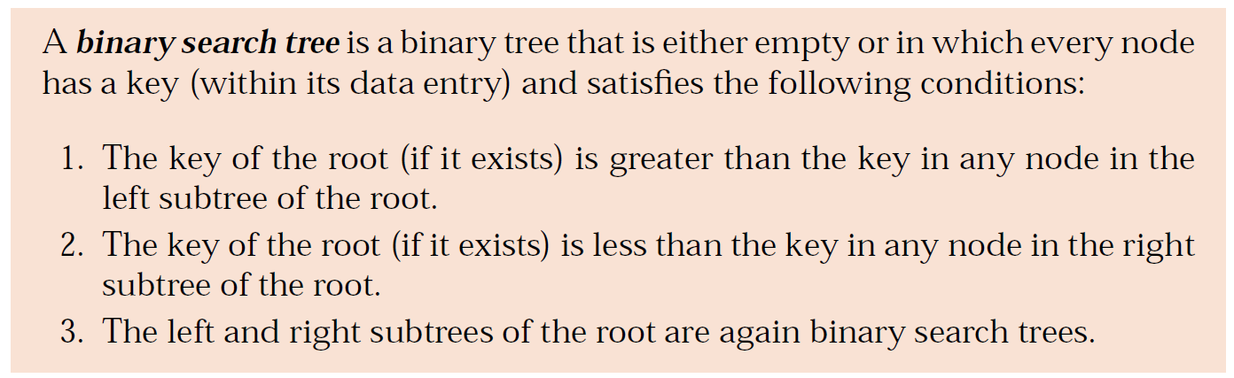

Binary Search Trees

Slide 5
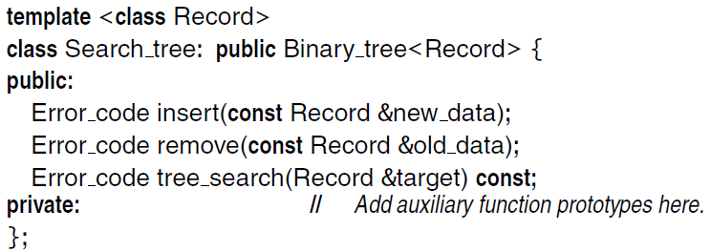
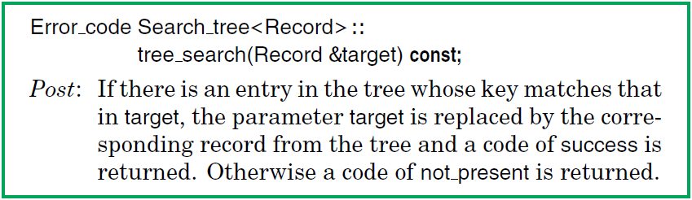
Binary Search Trees

Slide 6
Binary Search Trees
This method will often be called with a parameter target that contains only a key value. The method will fill target with the complete data belonging to any corresponding Record in the tree.
To search for the target, we first compare it with the entry at the root of the tree. If their keys match, then we are finished. Otherwise, we go to the left subtree or right subtree as appropriate and repeat the search in that subtree.
We program this process by calling an auxiliary recursive function.
The process terminates when it either finds the target or hits an empty subtree.

Slide 7
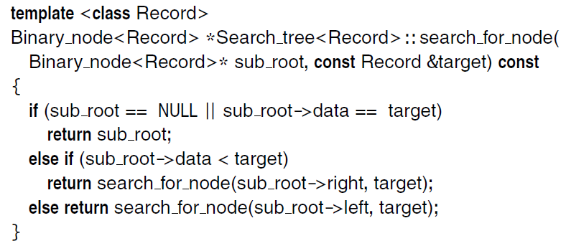
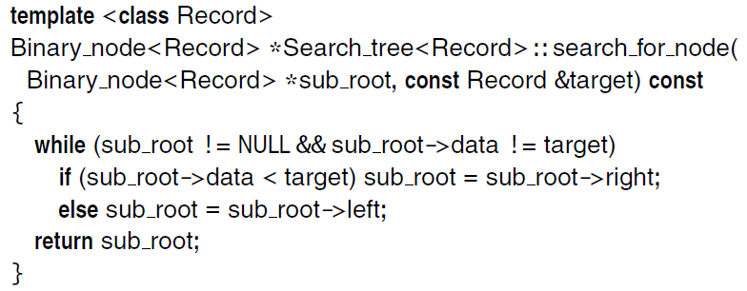
Recursive and Nonrecursive Auxiliary Functions

Slide 8
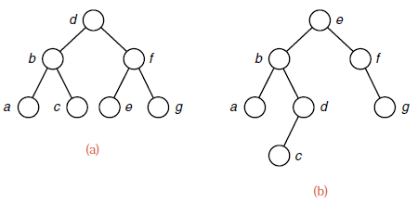
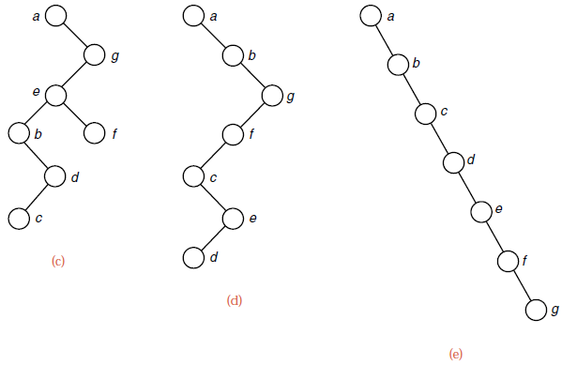
Several Binary Search Trees with the Same Keys

Slide 9
Tree Search
To search for the target, we first compare it with the entry at the root of the tree. If their keys match, then we are finished. Otherwise, we go to the left subtree or right subtree as appropriate and repeat the search in that subtree.
We program this process by calling an auxiliary recursive function.
The process terminates when it either finds the target or hits an empty subtree.

Slide 10
Analysis of Tree Search
The same keys may be built into binary search trees of many different shapes.
If a binary search tree is nearly completely balanced, then tree search on a tree with n vertices will also do O(log n) comparisons of keys.
If the tree degenerates into a long chain, then tree search becomes the same as sequential search, doing O(n) comparisons on n vertices. This is the worst case for tree search.
The number of vertices between the root and the target, inclusive, is the number of comparisons that must be done to find the target.
In practice, if the keys are built into a binary search tree in random order, tree search usually performs almost as well as binary search.

Slide 11
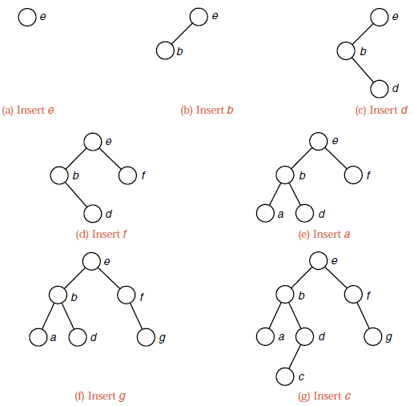
Insertion into a Binary Search Tree

Slide 12
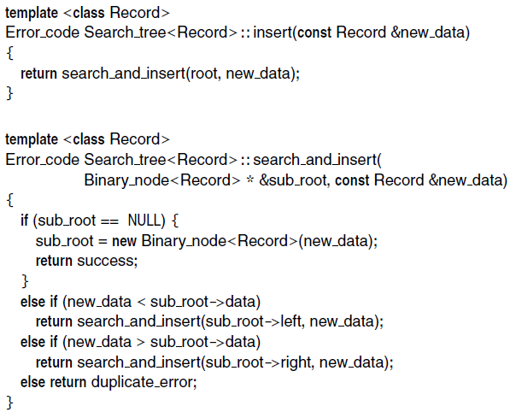
Method for Insertion

Slide 13
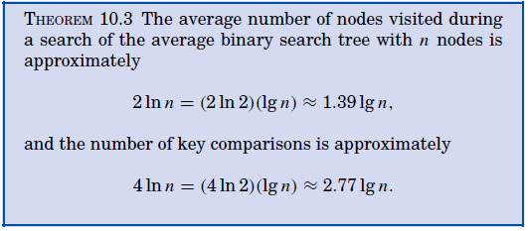
Performance of Random Binary Search Trees
Problem: If we assume that the keys have been inserted into a binary search tree in random order, then, on average, how many comparisons are needed?

Slide 14
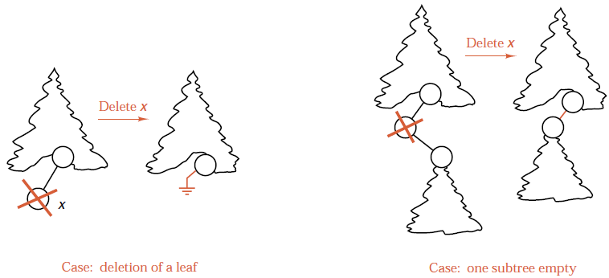
Removal from a Binary Search Tree

Slide 15
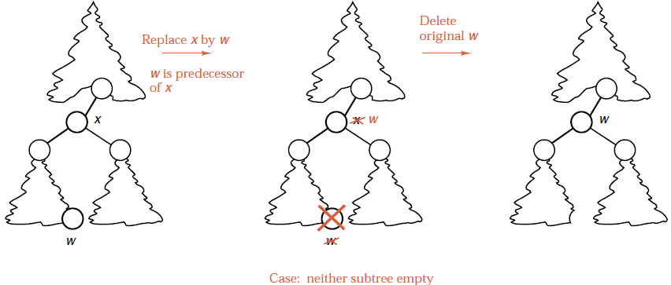
Removal from a Binary Search Tree
A node's in-order predecessor is the right-most child of its left sub-tree

Slide 16
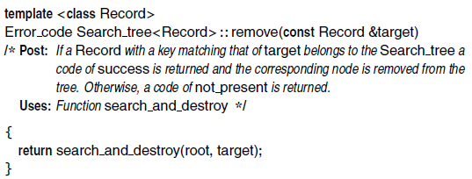
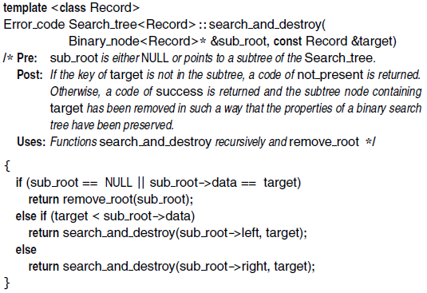
Removal Method

Slide 17
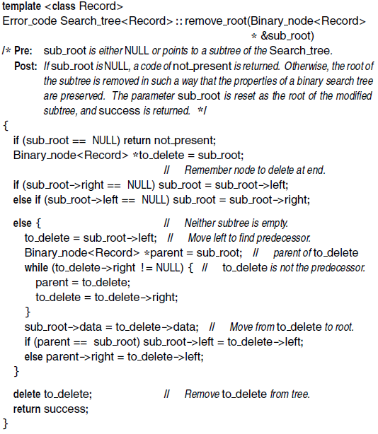
Auxiliary Function to Remove One Node
Note: You should trace through this function to check that all pointers are updated properly, especially in the cases when neither subtree is empty. We must carefully distinguish between the case where the left child of the root is its predecessor and the case where it is necessary to move right to find the predecessor. Note the steps needed in this final case to make the loop stop at a node with an empty right subtree,
but not to end at the empty subtree itself.

Slide 18
Exercise
Draw the binary search tree according to the following operations.
Insert 3
Insert 6
Insert 7
Insert 2
Insert 4
Insert 5
Delete 6
Delete 3

Slide 19
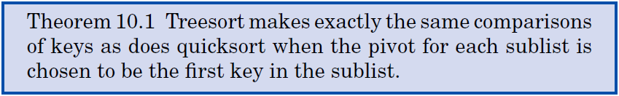
Treesort
When a binary search tree is traversed in inorder, the keys will come out in sorted order.
This is the basis for a sorting method, called treesort: Take the entries to be sorted, use the method insert to build them into a binary search tree, and then use inorder traversal to put them out in order.

Slide 20
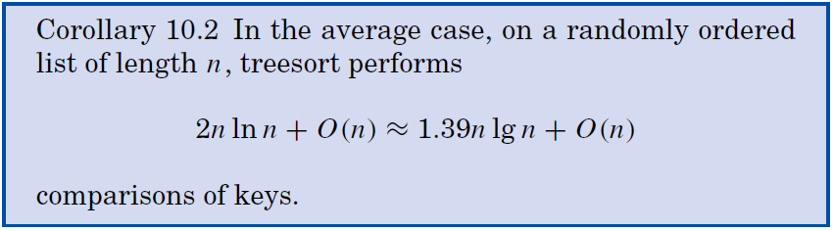
Treesort
First advantage of treesort over quicksort: The nodes need not all be available at the start of the process, but are built into the tree one by one as they become available.
Second advantage: The search tree remains available for later insertions and removals.
Drawback: If the keys are already sorted, then treesort will be a disaster -- the search tree it builds will reduce to a chain. Treesort should never be used if the keys are already sorted, or are nearly so.

Slide 21

Thank you!

